Slide 1

Income Classification
Shailesh Dargude
2020

Slide 2
Project Objective
1. Exploring techniques to handle a highly imbalanced and sparse dataset.
2. Develop a solution for a business problem.

Slide 3
Business Problem
Snap-shot LLC prepares to Launch a high-end digital camera.
For the marketing/sales campaign, Company comes with Hypothesis which corelates certain income individual can be potential customers.
Company decides to conduct a survey which would help to gain/predict insights into income of an individual, without asking financial questions
Problem is the identify right set of questions for an individual.

Slide 4
Solution
Since demographics changes per area location, company decides to make use of Census data to come-up with most important features, to be asked for people taking the survey from the location, based on the IP address of the online user.
Data:
The American Community Survey(ACS) helps local officials, community leaders, and businesses understand the changes taking place in their communities
The Data is per zip code and labeled with users greater or less than $50000.

Slide 5
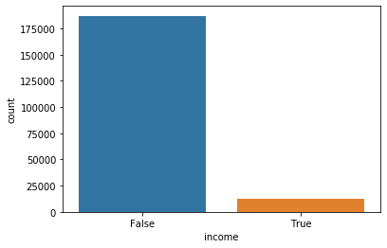
Data Exploration
Imbalanced Data
# of Features 39
# >$50000 76k
# < $50000 152k

Slide 6
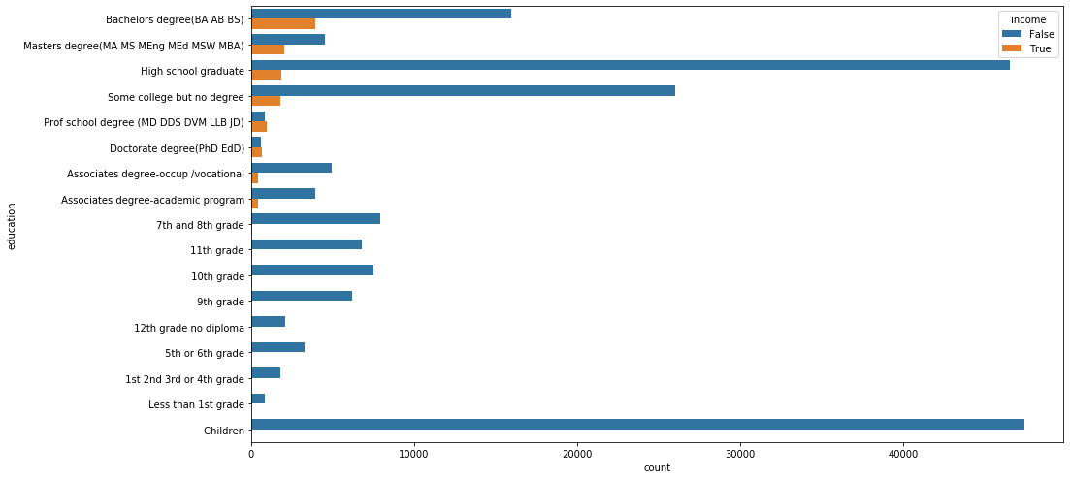
Data Exploration
Education Distribution
Action:
Remove Children and People with education less than 8th grade

Slide 7
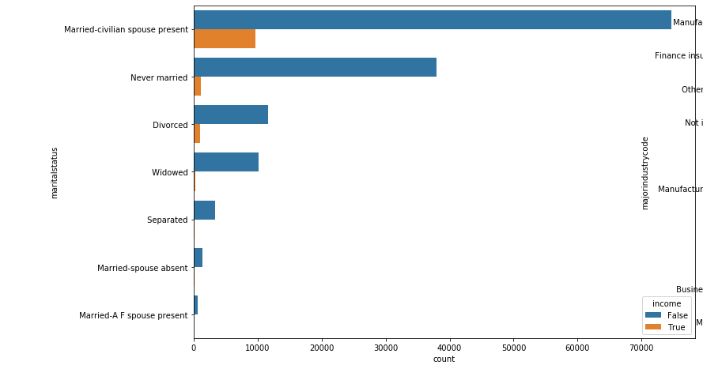
Data Exploration
Martial Status

Slide 8
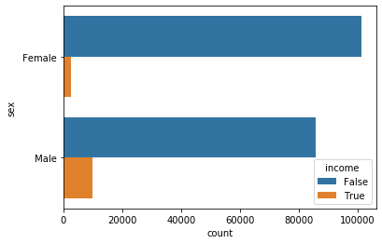
Data Exploration
Sex

Slide 9
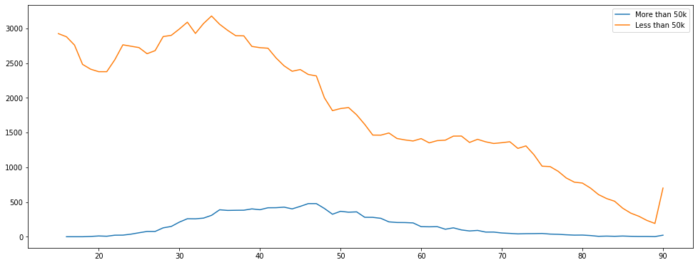
Data Exploration
Age
# People between 30-60

Slide 10
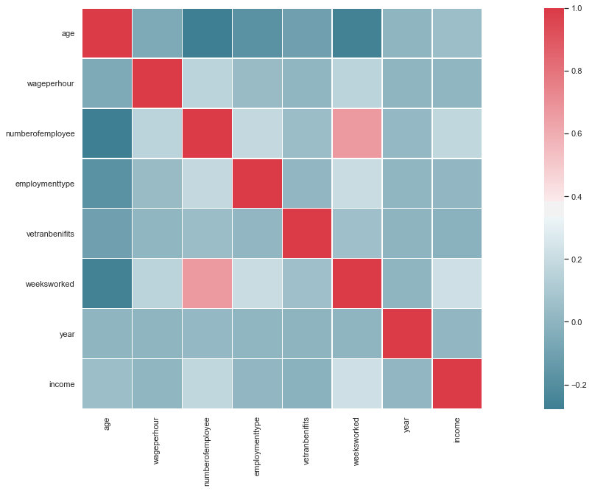
Data EXPLORATION
Corelating Various Features
Not significantly corelated features.

Slide 11
Training A Classifier
Algorithms used
Random Forest Classifier: Is a decision tree-based ensemble model using bagging technique.
AdaBoostClassifier: Is a decision tree-based ensembled model using boosting technique.
GraidientBoosting Classifier: Is a decision tree-based ensembled model using boosting technique

Slide 12
Techniques to Handle Imbalanced Dataset
Performance Metrics: Choosing right metrics for model evaluation. E.g. Confusion Matrix, Precision-Recall, F1, ROC.
Multiple Algorithms: It’s a good rule of thumb to try variety of algorithms, it is especially true for imbalanced Dataset.
Resampling: Resampling (Under or Over Sampling) can be defined as adding more/less copies of the minority/Majority class.
Synthetic Samples: This is a probabilistic approach where new samples of minority class can be generated.

Slide 13
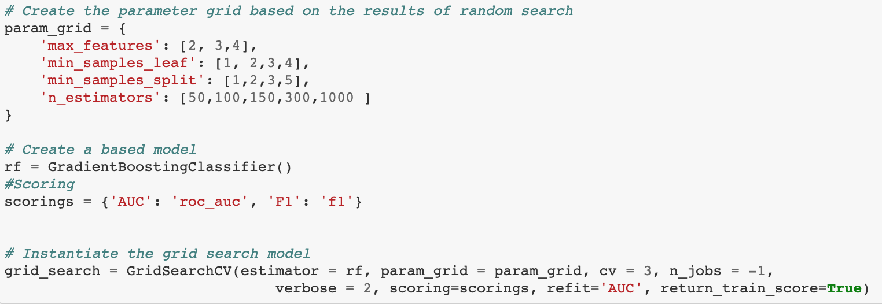
Hyperparameter Tunning
Machine learning models are parameterized using multiple parameters.
Best way to find optimum parameters can be done by GridSearchCV.

Slide 14
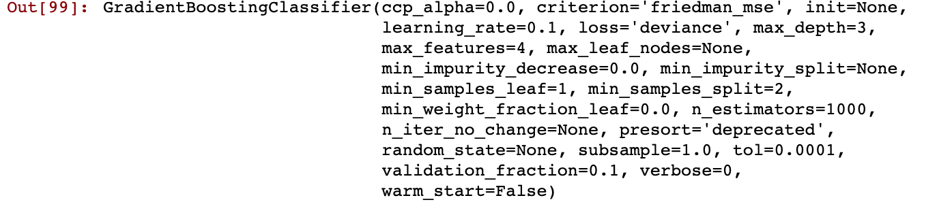
Selecting Optimum Parameters

Slide 15
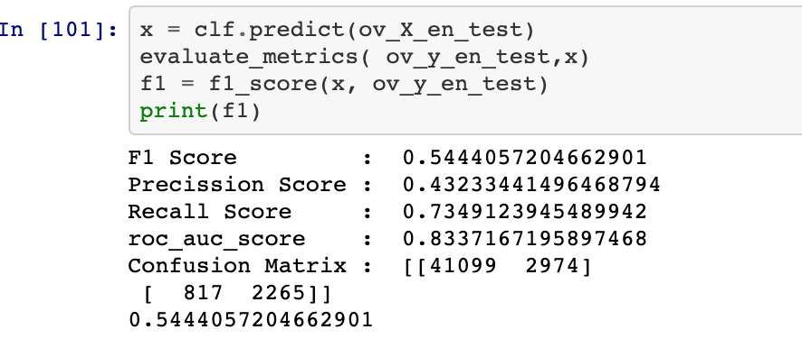
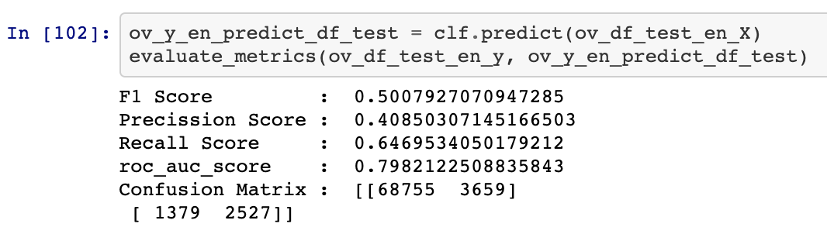
Model Performance
Over Sampled Data
No Over Sampling

Slide 16
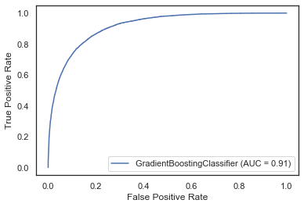
Model Performance
ROC curve plotted against False Positive and True Positive Rate

Slide 17
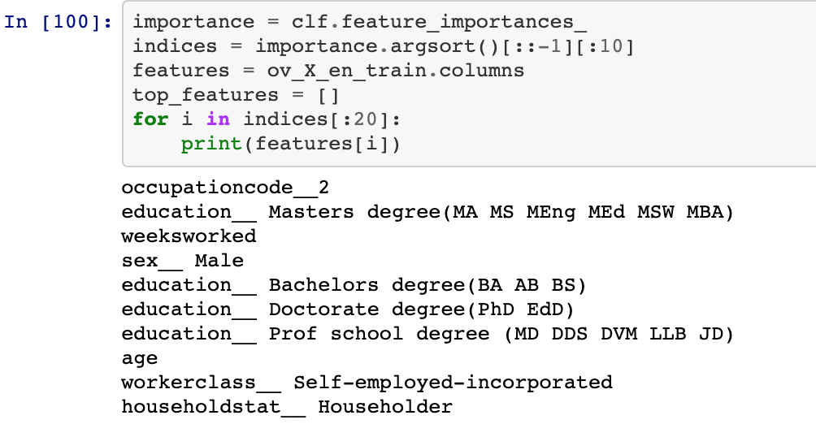
Model Explanation
Ability to explain the model helps in understanding data and hence the predictions.

Slide 18
Conclusion
Every Zip code is unique and different parameters dominate social and economical levels of residents.
Snapshot would need to build a framework to build a model per zip code or group of zip codes , to get localized parameters.
Handling Imbalance in data set is difficult and requires extra steps to train the model.

Slide 19
Acknowledgements
Special Thanks to my mentor Nathan Sutton for all the help and advice whenever required.

